Slide 2
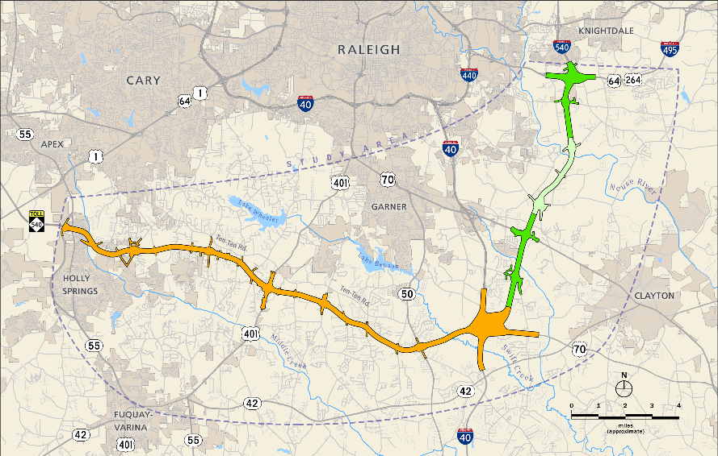

Slide 3
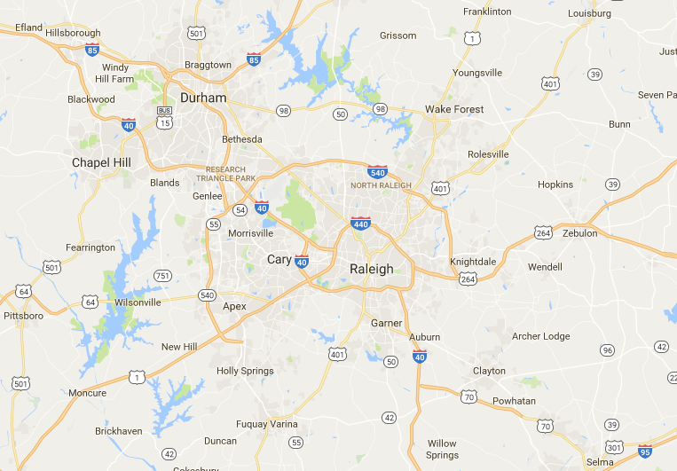

Slide 4
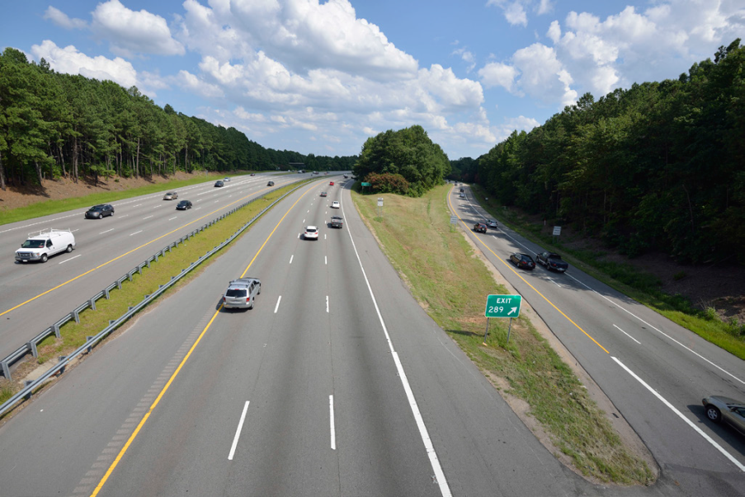

Slide 5
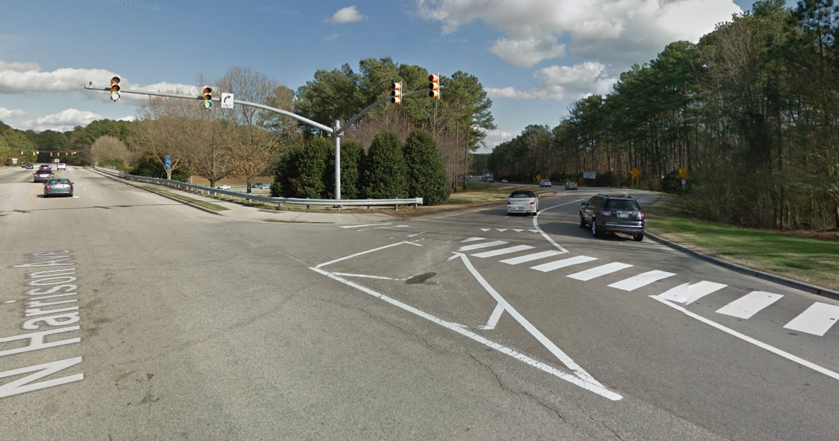

Slide 6
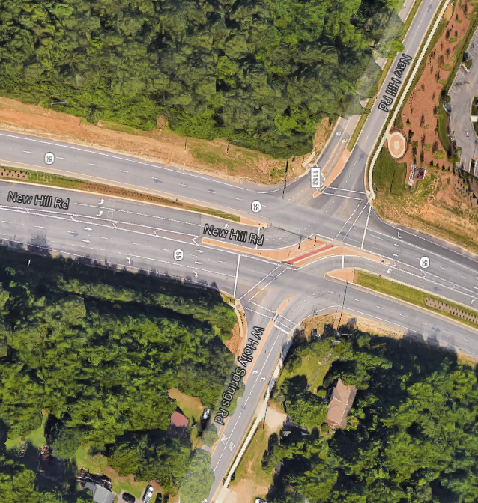

Slide 7
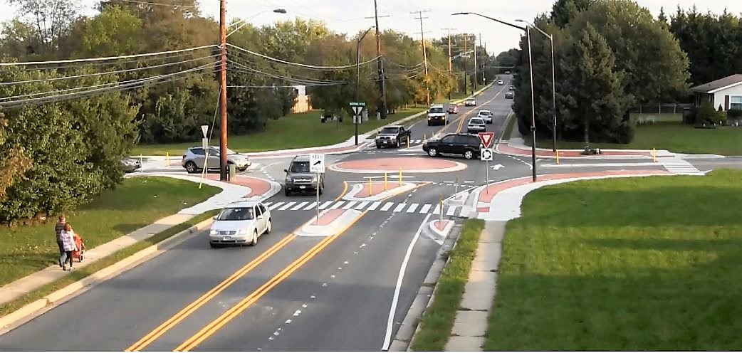

Slide 8
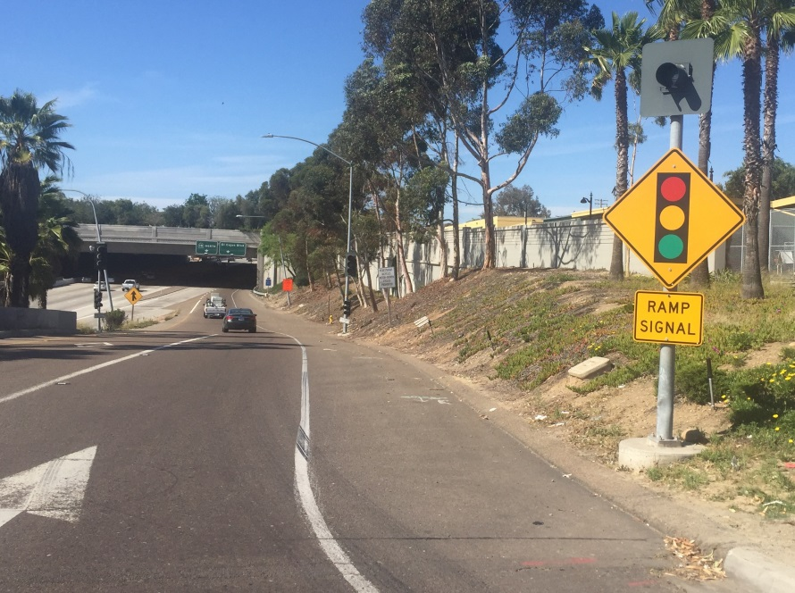

Slide 9
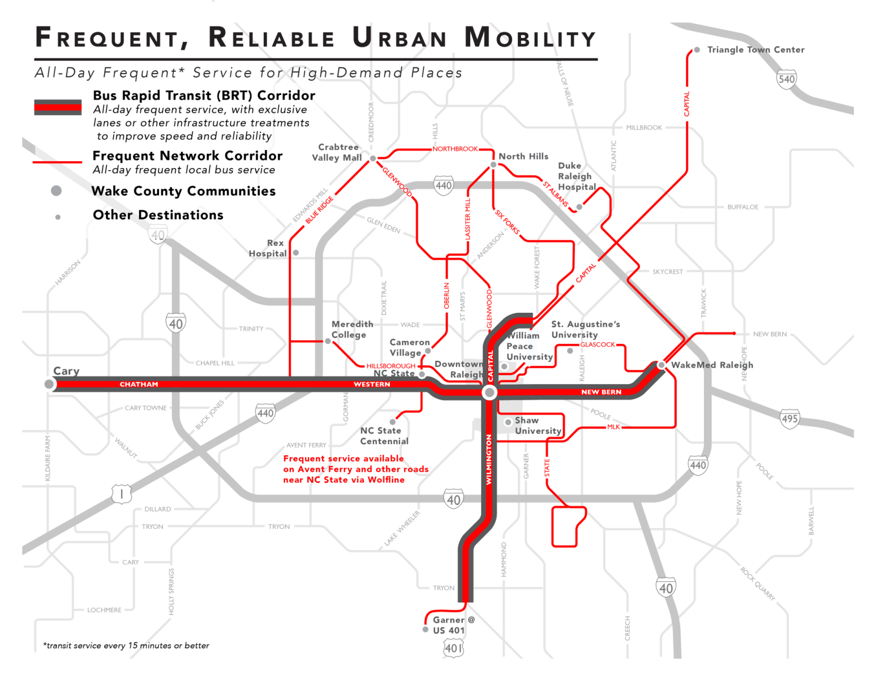

Slide 10
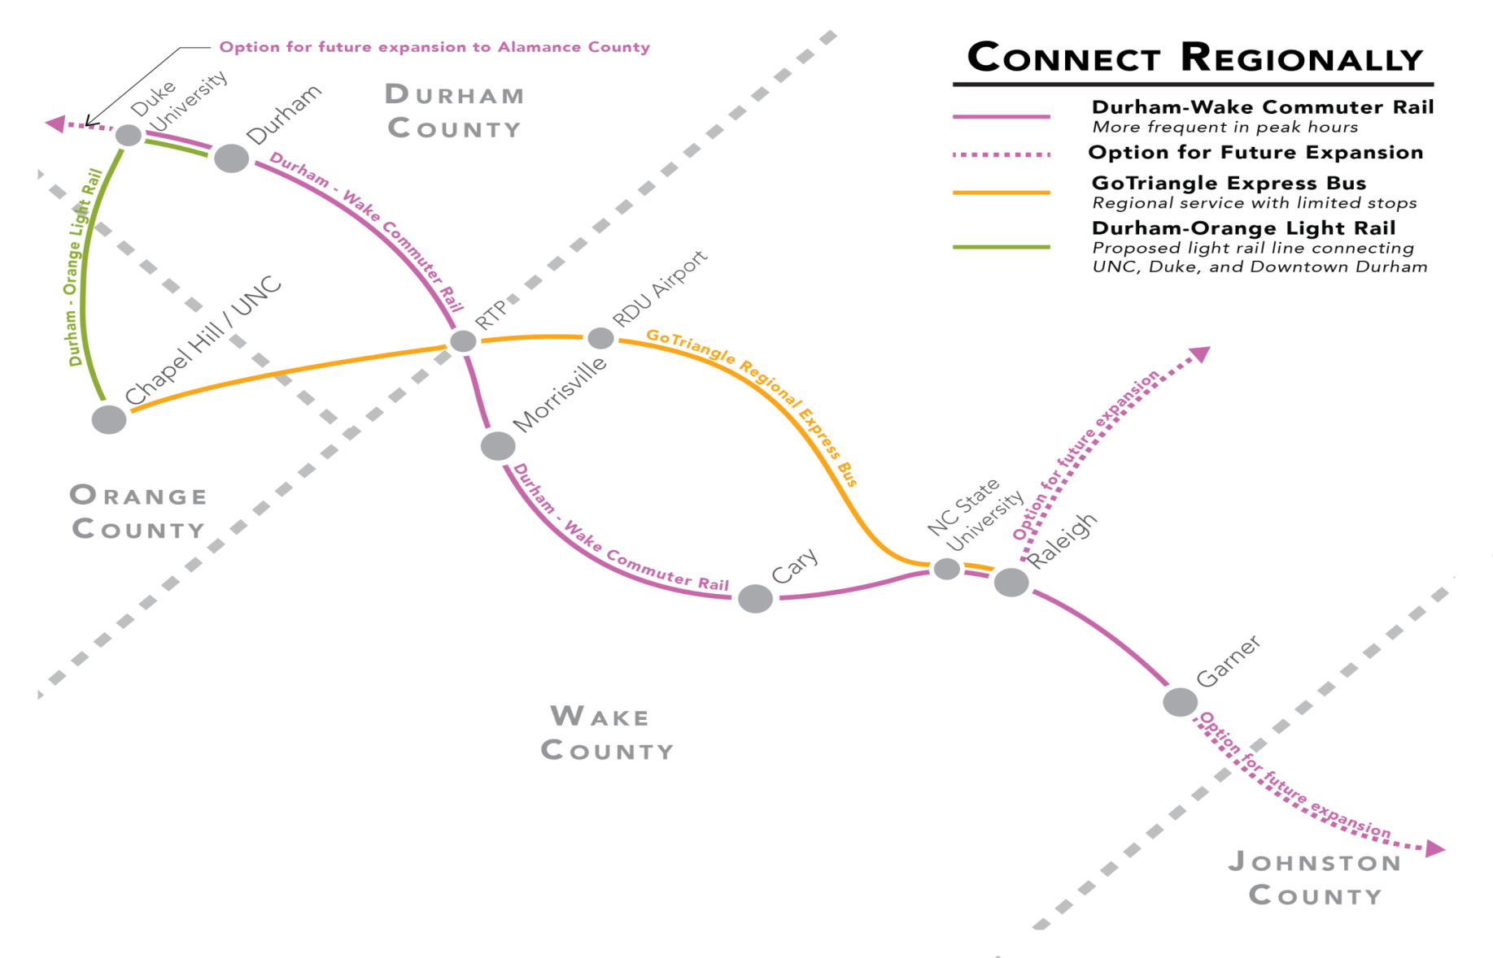

Slide 11
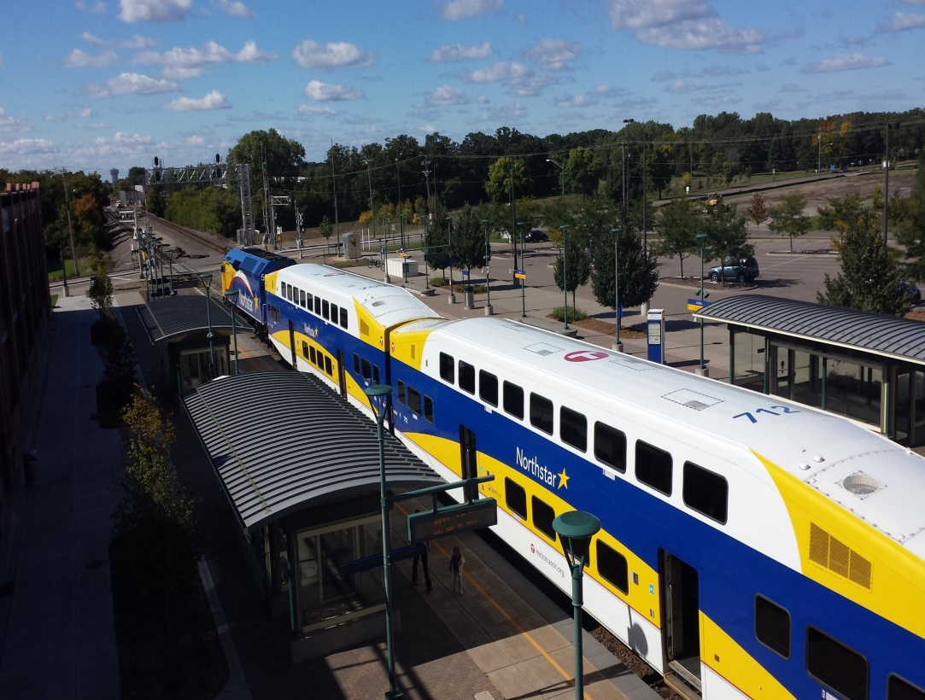

Slide 12
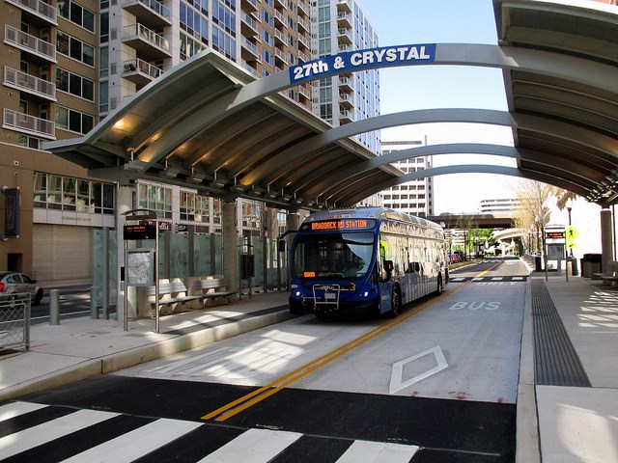

Slide 14
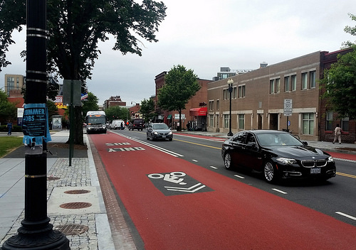

Slide 16
% “Ultimate” amenities
Years

Slide 17
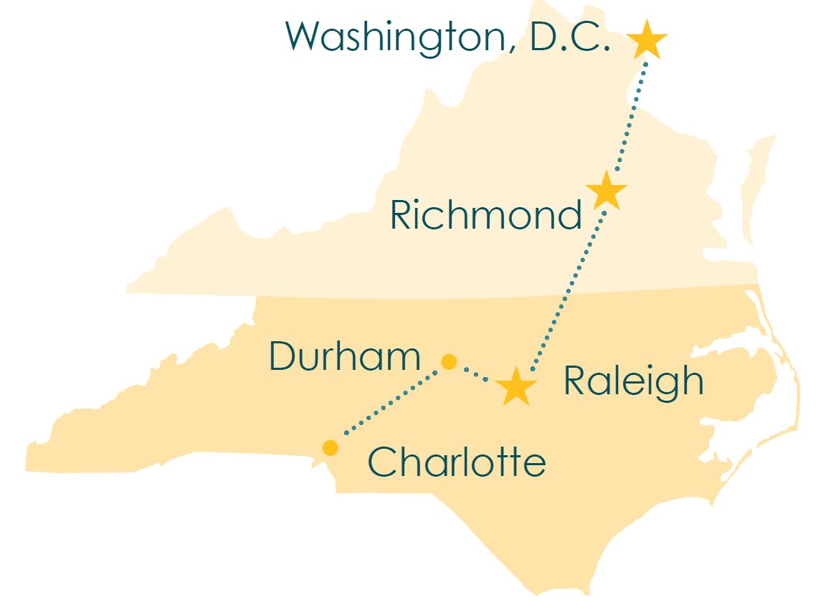

Slide 19
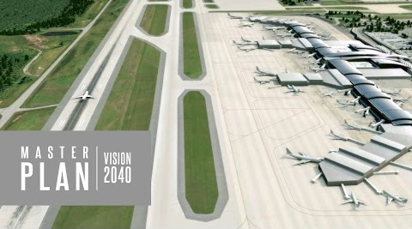

Slide 20
Notes:
This Bond Project realigns CFS between Louis Stephens and NC 55 and includes a grade separated r/r crossing.
Rendering is looking west toward NC 55 from Saunders Grove Rd.
Construction is scheduled to begin in 2018.
We are beginning design preparations to improve CFS west of NC 55 to NC 540 that was included in FY 18 budget

Slide 21
Notes:
This Bond Project realigns CFS between Louis Stephens and NC 55 and includes a grade separated r/r crossing.
Rendering is looking west toward NC 55 from Saunders Grove Rd.
Construction is scheduled to begin in 2018.
We are beginning design preparations to improve CFS west of NC 55 to NC 540 that was included in FY 18 budget

Slide 22
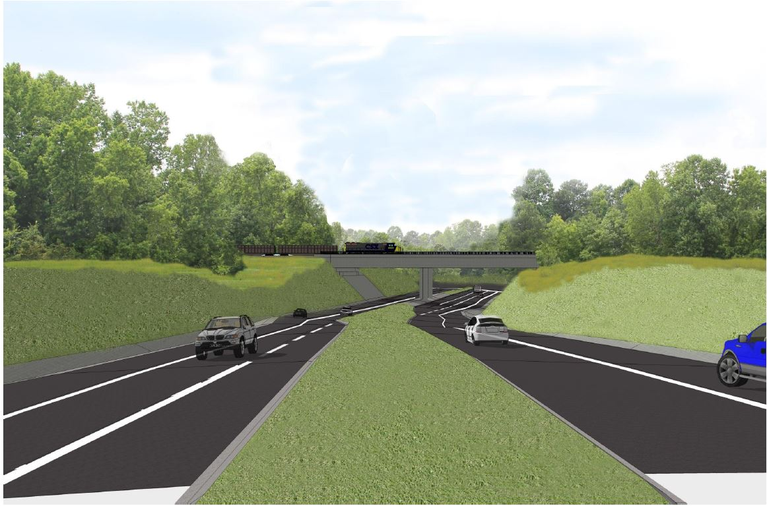
Carpenter Fire Station Road Grade Separation
Notes:
This Bond Project realigns CFS between Louis Stephens and NC 55 and includes a grade separated r/r crossing.
Rendering is looking west toward NC 55 from Saunders Grove Rd.
Construction is scheduled to begin in 2018.
We are beginning design preparations to improve CFS west of NC 55 to NC 540 that was included in FY 18 budget

Slide 23
Notes:
This Bond Project realigns CFS between Louis Stephens and NC 55 and includes a grade separated r/r crossing.
Rendering is looking west toward NC 55 from Saunders Grove Rd.
Construction is scheduled to begin in 2018.
We are beginning design preparations to improve CFS west of NC 55 to NC 540 that was included in FY 18 budget

Slide 24
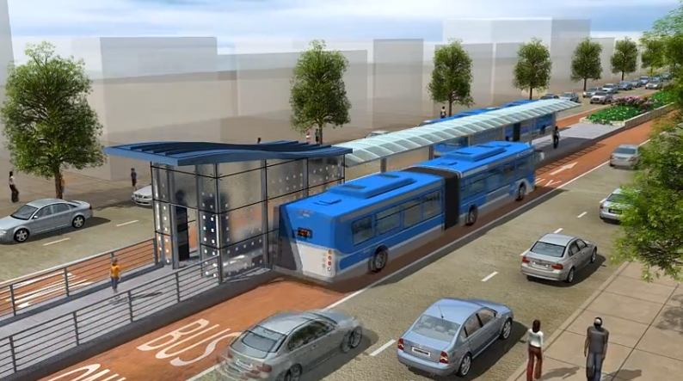
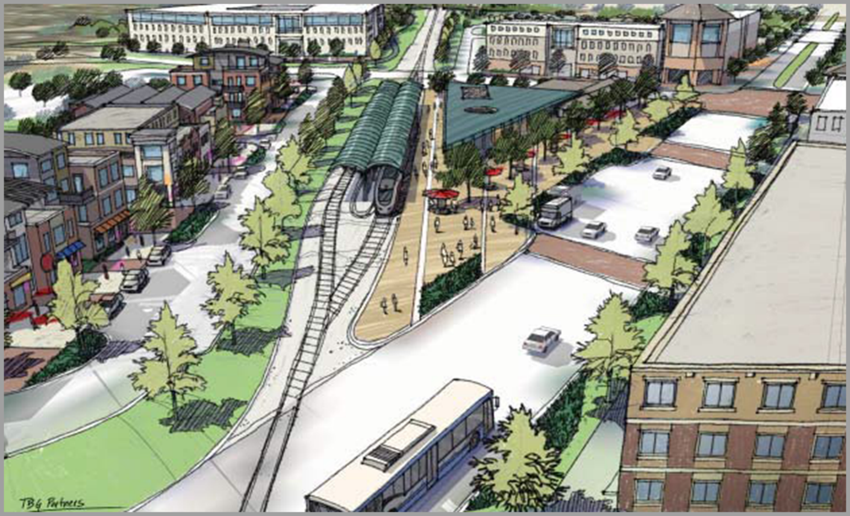
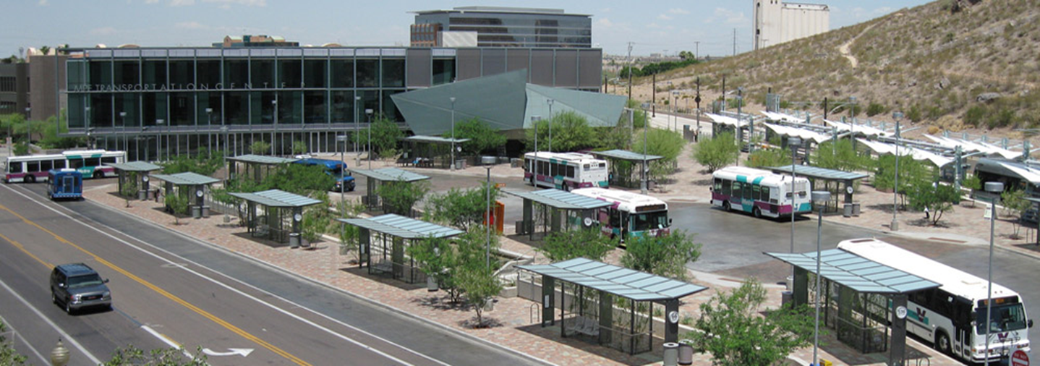
Multimodal Center and Bus Rapid Transit (BRT)
Example from City of Houston, TX
Tempe, AZ
Notes:
A planning study to evaluate downtown corridors best suited for Bus Rapid Transit, or BRT, is set to begin this quarter. This study will also evaluate sites in the vicinity of Downtown to become the home for Cary’s new multimodal transportation center.

Slide 25
Notes:
This Bond Project realigns CFS between Louis Stephens and NC 55 and includes a grade separated r/r crossing.
Rendering is looking west toward NC 55 from Saunders Grove Rd.
Construction is scheduled to begin in 2018.
We are beginning design preparations to improve CFS west of NC 55 to NC 540 that was included in FY 18 budget

Slide 26
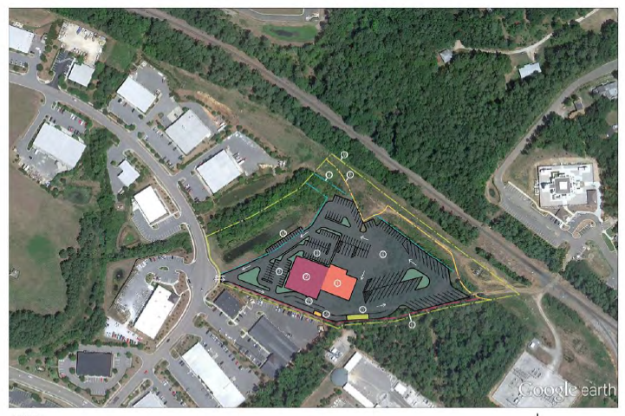
Bus Operations & Maintenance Facility
Public Works
Notes:
The second major project for transit is the design of a new bus operations & maintenance facility. The Town just purchased the land outlined in this map. The site layout is taken from a feasibility study conducted a few years ago. This facility will serve all GoCary operations & maintenance needs, as well as similar needs for some regional services provided through GoTriangle. Public Works is located just behind this site.

Slide 27
Notes:
This Bond Project realigns CFS between Louis Stephens and NC 55 and includes a grade separated r/r crossing.
Rendering is looking west toward NC 55 from Saunders Grove Rd.
Construction is scheduled to begin in 2018.
We are beginning design preparations to improve CFS west of NC 55 to NC 540 that was included in FY 18 budget

